Slide 1
Intro to Biotech
Lect.5
How is DNA propagated ?
1. Replication
2. Segregation
Genetic modification of organism – is DNA properly transmitted?

Slide 2
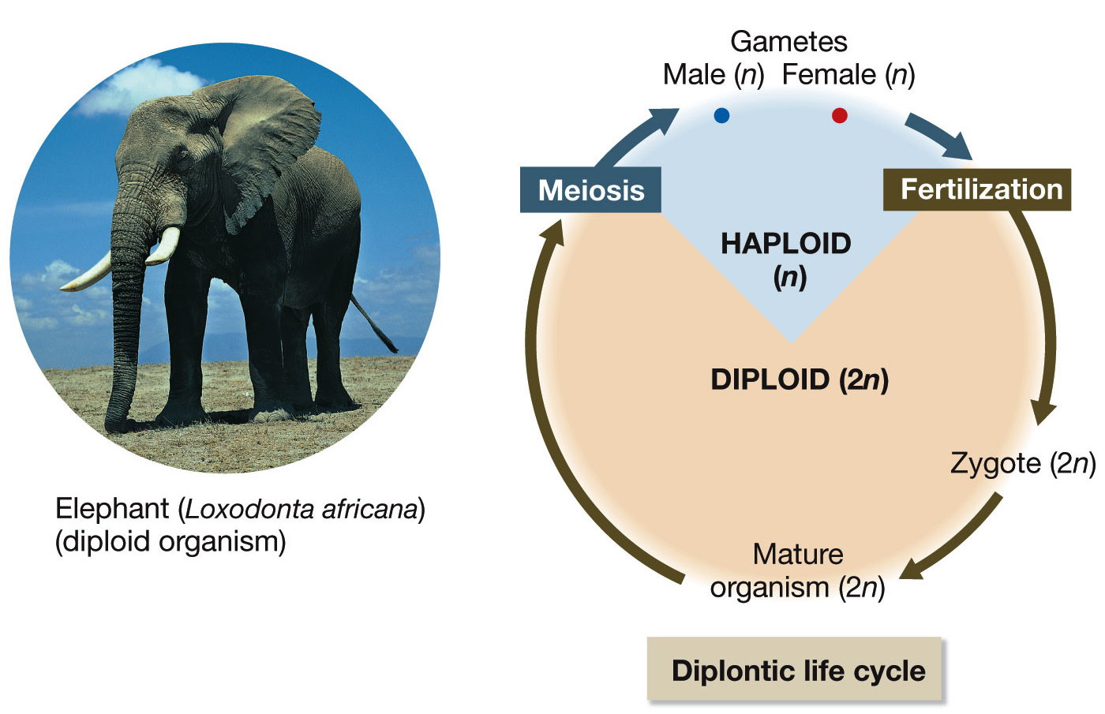
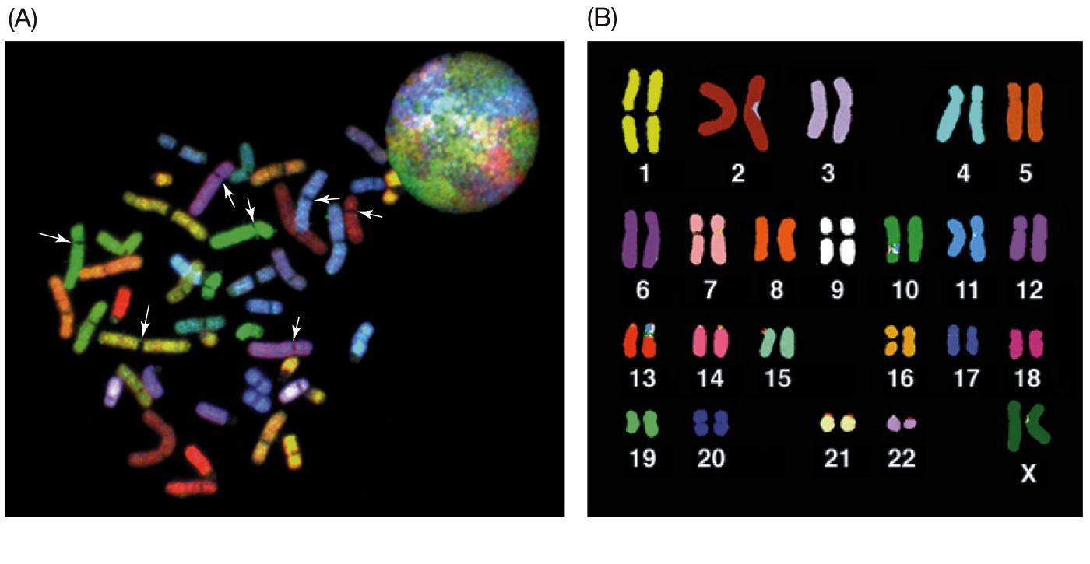
Intro to Biotech
Lect.5
How is DNA propagated ?
1. Replication
2. Segregation
Genetic modification of organism – is DNA properly transmitted?
Life cycle
Karyotype:

Slide 3
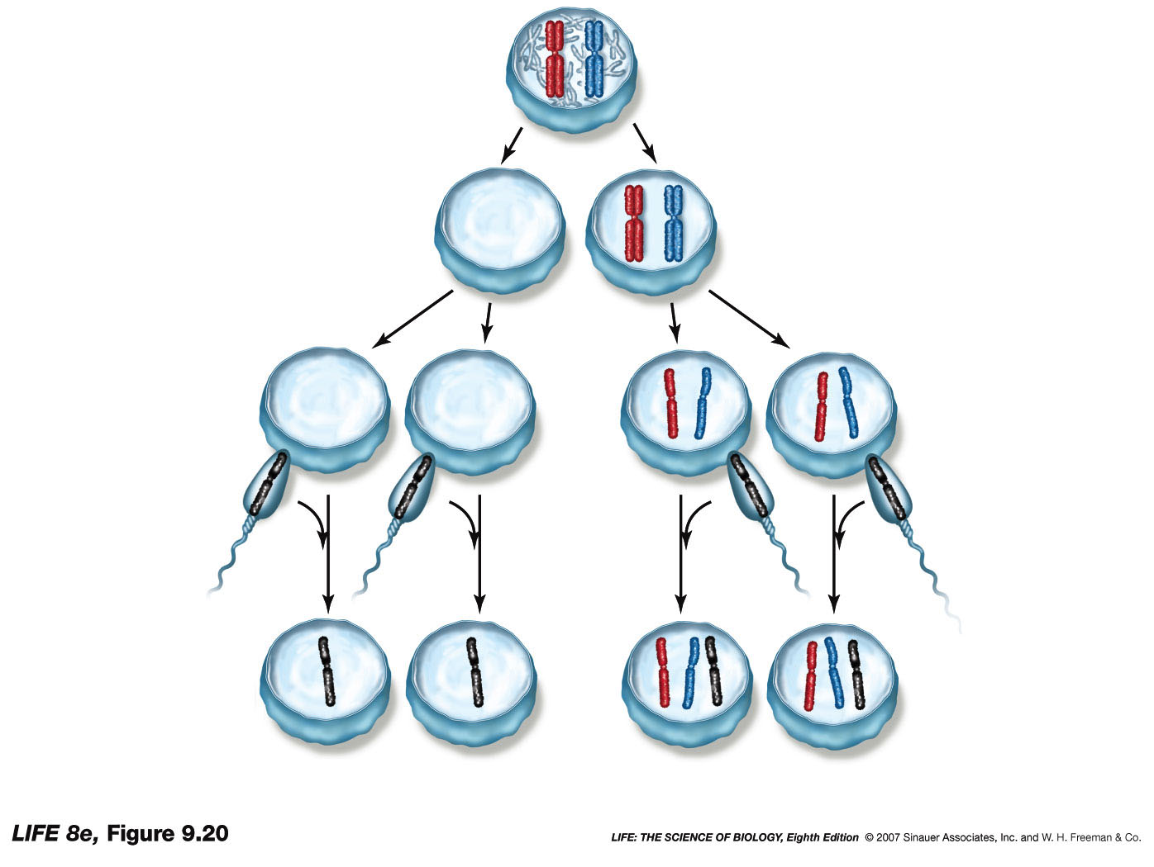
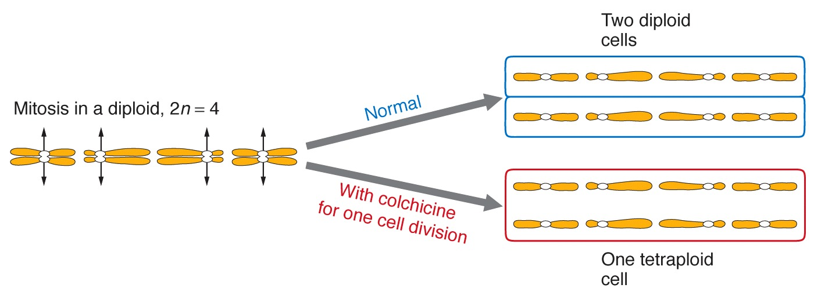
Intro to Biotech
Lect.5
How is DNA propagated ?
1. Replication
2. Segregation
Alter segregation – what happens?
Alter segregation – alter ploidy (possible uses?)
a. aneuploid:
b. polyploid:
How?

Slide 4
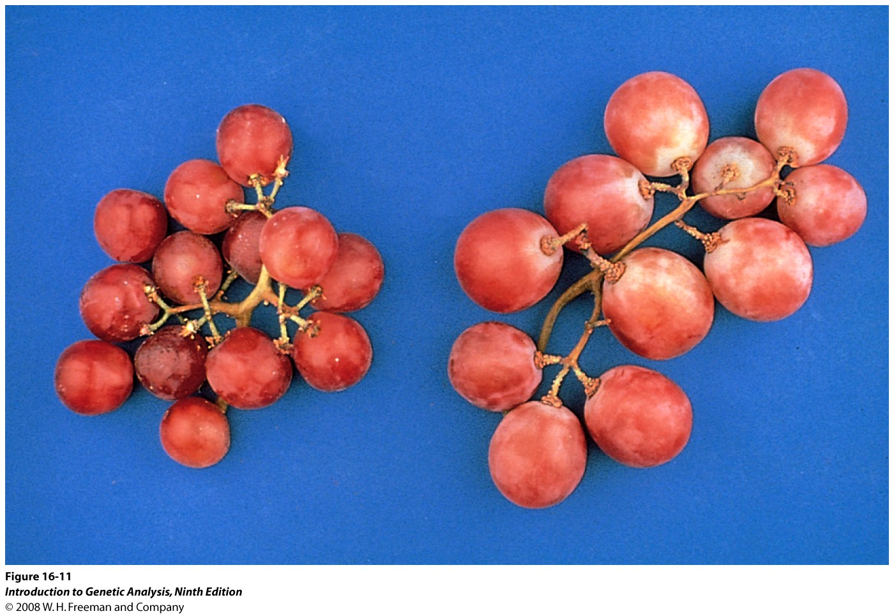
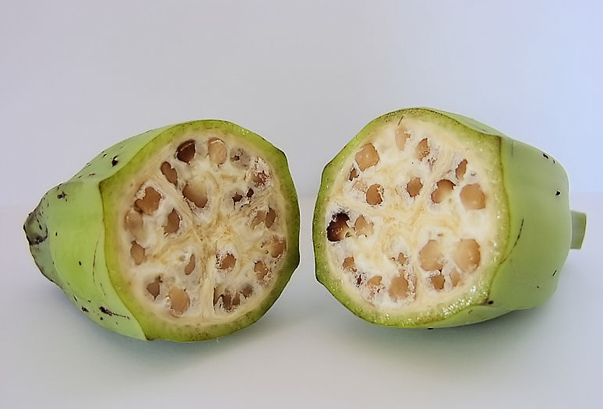
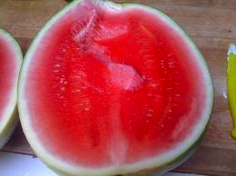
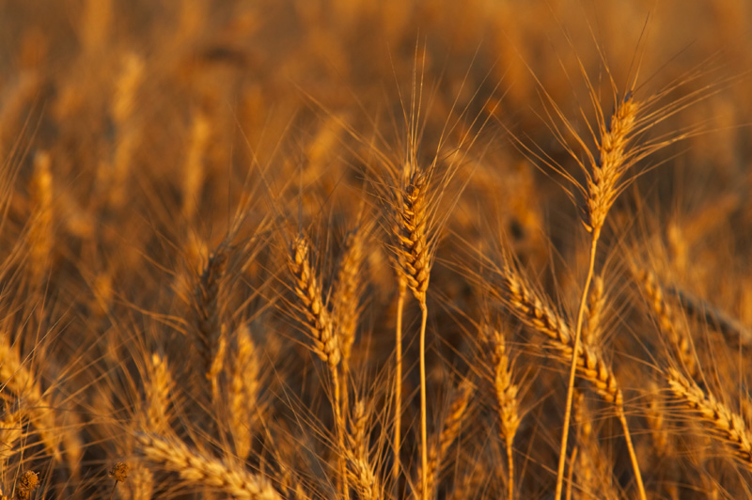
Intro to Biotech
Lect.5
How is DNA propagated ?
1. Replication
2. Segregation
Alter segregation – alter ploidy (possible uses?)
Autotetraploid
Seedless
New species
2n + 2n
Polyploidy
• 90% angiosperms
•
•
Triticum urartu (AA) X Aegilops speltoides (BB)
Triticum turgidum (AABB) X Triticum tauschii (DD)
Triticum aestivum (AABBDD)
(bread wheat)

Slide 5
Intro to Biotech
Lect.5
How is DNA propagated ?
1. Replication
2. Segregation
Mitosis vs Meiosis
Divisions
Ploidy
Hom. Pairing
Crossovers
Centromeres
Promotes
variation
Assortment
Genetic modification of organisms:
Is DNA properly transmitted?

Slide 6
Intro to Biotech
Lect.5
How is DNA propagated ?
1. Replication
2. Segregation
Genetic modification of organism – is DNA properly transmitted?
- requires what?
How are homologous chromosomes segregated in meiosis?
1. Mendel’s 1st law -
Alleles:
Mendel’s 1st law –

Slide 7
Intro to Biotech
Lect.5
How is DNA propagated ?
1. Replication
2. Segregation
Genetic modification of organism – is DNA properly transmitted?
How are different chromosomes segregated in meiosis?
2. Mendel’s 2nd law

Slide 8
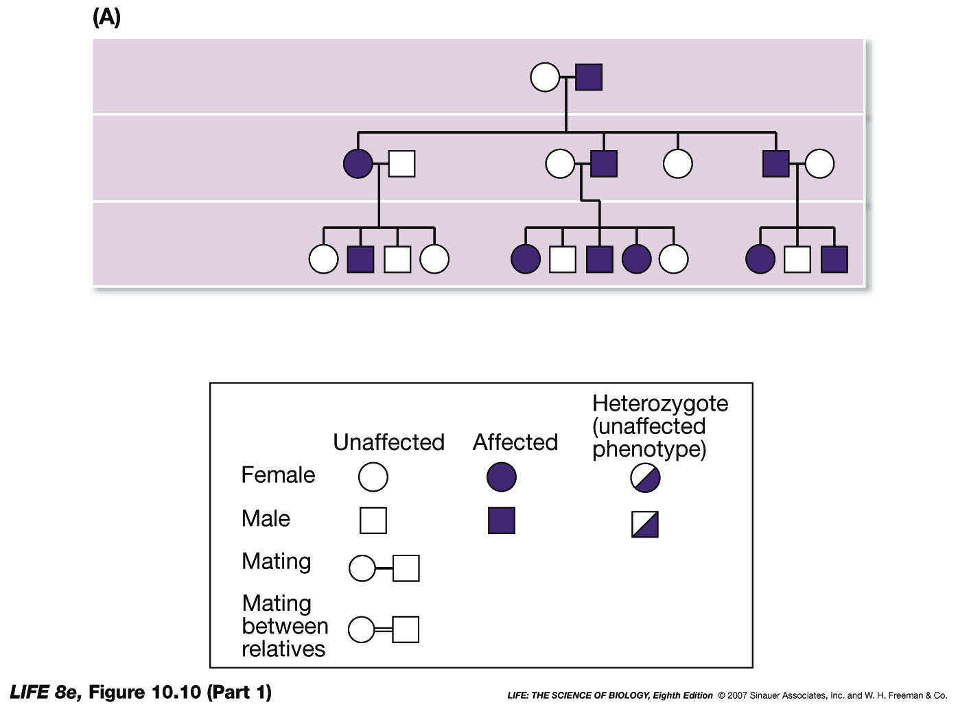
Intro to Biotech
Lect.5
How is DNA propagated ?
1. Replication
2. Segregation
Genetic modification of organism – is trait properly transmitted?
Mendel’s laws - heredity - determine inheritance patterns
• Alleles:
wild type vs mutant
1. Dominant
2. recessive –
3. codominance (blood type) -
• Homozygous vs Heterozygous
Pedigree analysis
Generation I (parents)
Generation II
Generation III
Inheritance pattern?
Dominant – clues?

Slide 9
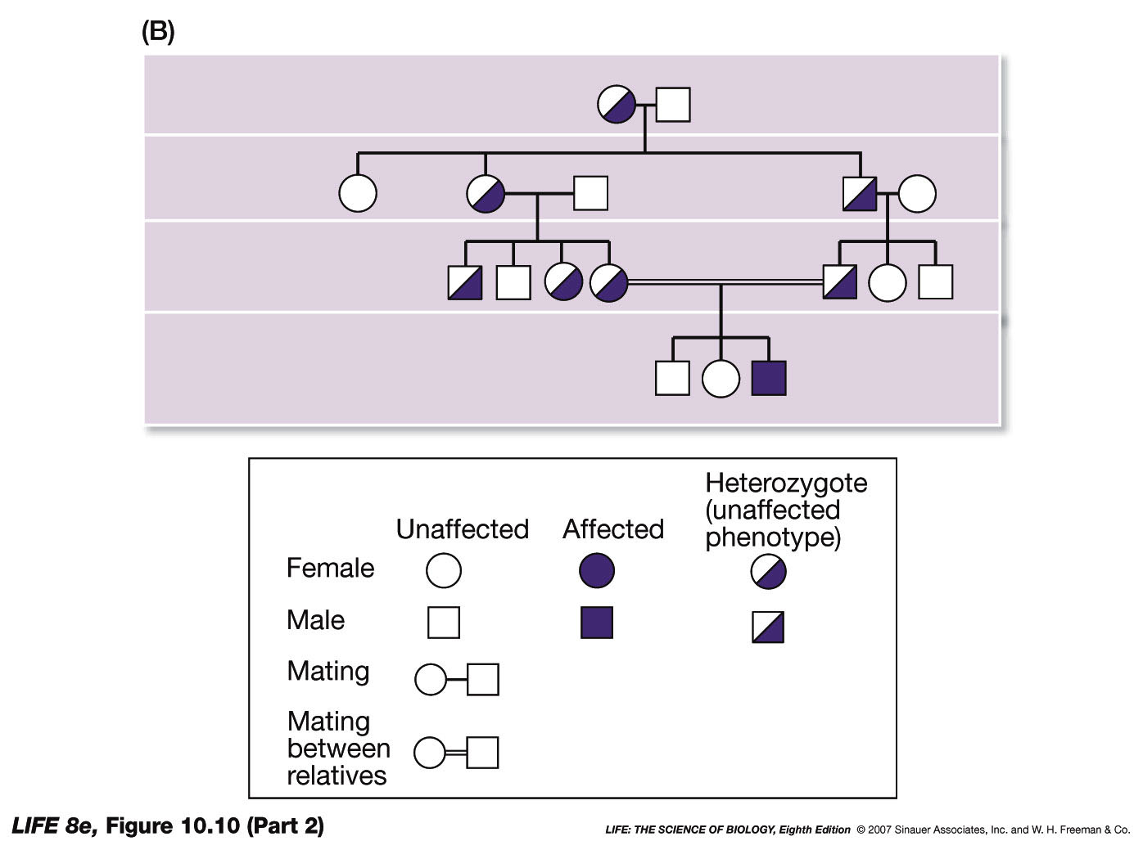
Intro to Biotech
Lect.5
How is DNA propagated ?
1. Replication
2. Segregation
Mendel’s laws - heredity - determine inheritance patterns
Pedigree analysis
Generation I (parents)
Generation II
Generation III
Generation IV
Inheritance pattern?
Recessive – clues?
Is there a difference b/w
autosomes vs sex chromosomes?

Slide 10
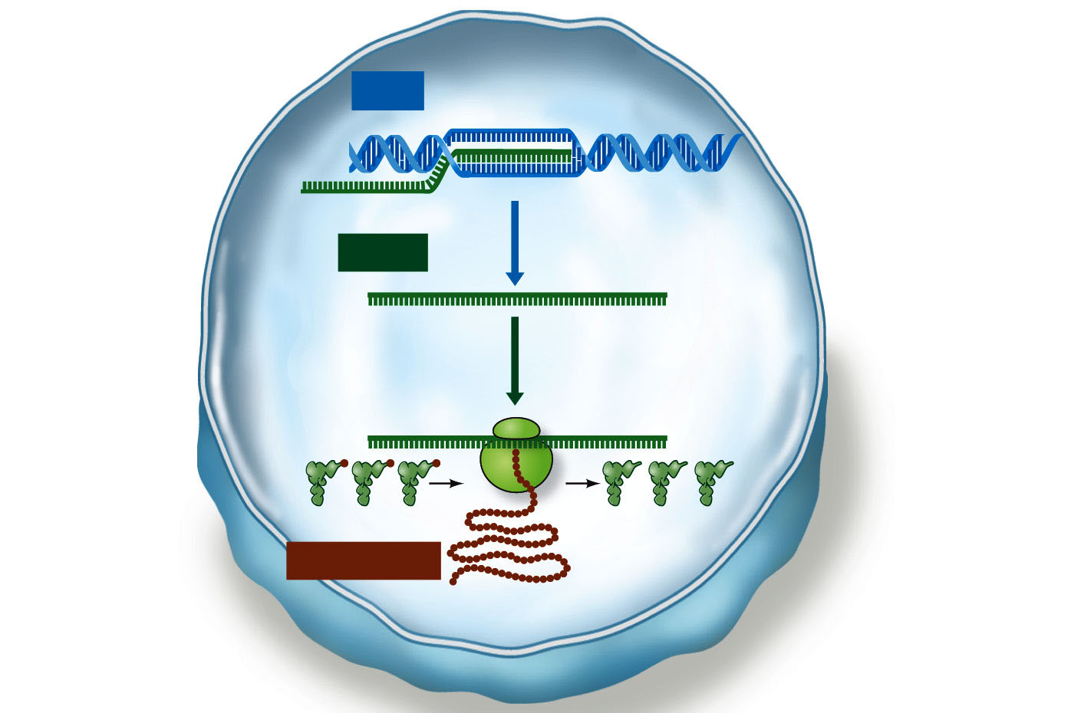
Intro to Biotech
Lect.5
Mendel’s laws - heredity
• segregation of chromosomes/genes
• how do genes control heredity?
Genetically modified organisms
- how confirm organism is modified
- how ensure modification is propagated
- in what way is modification manifested (r or D)
DNA
mRNA
transcription
translation
Protein
tRNAs

